Slide 1
Secure data hiding in images using steganography
CAPSTONE PROJECT
Presented By:
Student Name : Dharmavarapu Bhargavi
College Name & Department : Vignan’s Institute Of Engineering For Women
Department: Computer Science and Engineering

Slide 2
OUTLINE
Problem Statement
Technology used
Wow factor
End users
Result
Conclusion
Git-hub Link
Future scope

Slide 3
Problem Statement
This project implements image steganography, where secret messages are embedded inside images by modifying pixel values. The objective is to provide secure and hidden communication while preserving the image's visual integrity. The hidden message can later be retrieved and decrypted using a simple extraction process.

Slide 4
Technology used
Programming Language: Python
Libraries Used:
OpenCV (for image processing)
OS (for file handling)

Slide 5
Wow factors
Invisible Message Encoding: The secret message is hidden within image pixels without noticeable distortion.
Secure Communication: The message is encrypted in an image, making it difficult for unauthorized users to detect.
Password Protection (Optional): Can be extended to require a password for decryption.
No Additional Storage Requirement: The image size remains nearly unchanged.

Slide 6
End users
Cybersecurity Enthusiasts – To explore data hiding techniques.
Forensic Analysts – To hide confidential information securely.
Journalists & Whistleblowers – To communicate securely without detection.
Data Security Professionals – For steganography research and secure data transfer.

Slide 7
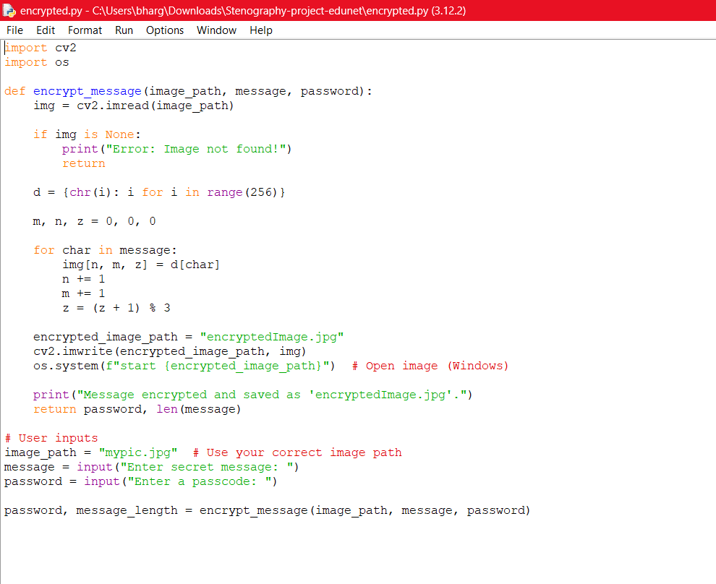
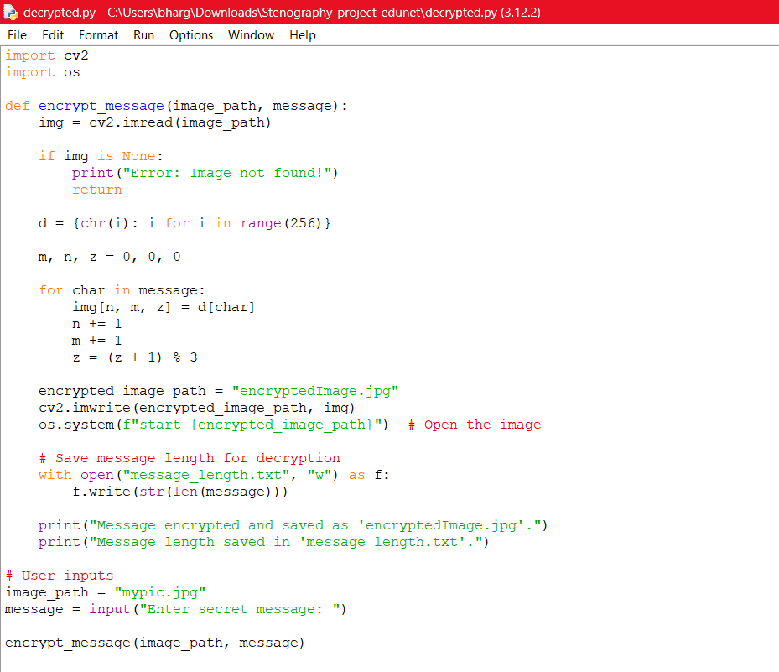


Results
Input Image File:
Output Image File:

Slide 8
Conclusion
This project successfully demonstrates image-based steganography for secure text encoding and retrieval. By modifying pixel values, secret messages are hidden within images, ensuring safe and covert communication. The approach is simple, effective, and can be extended for more advanced security applications.

Slide 9
GitHub Link
https://github.com/DharmavarapuBhargavi/aicte-edunet-project.git

Slide 10
Future scope(optional)
Enhancing security by implementing AES encryption before embedding messages.
Developing a GUI-based application for user-friendly text embedding and extraction.
Supporting different file formats like PNG, BMP, and GIF for enhanced flexibility.
Implementing AI-based detection methods to prevent unauthorized steganography usage.

Slide 11
THANK YOU

